Slide 1


Creating Effective
Poster Presentations
30” X 42”

Slide 2
The Rules of Poster Printing
All Posters’ file names will be as follows:
“Instructor’s Name - Your Name or Group Number - Course # .pptx”
Example: “Rowe-Group 14-Nur350.pptx
2. All posters must be reviewed and approved by your instructor BEFORE printing.
3. One poster per customer! PROOF your work.
4. Printing typically takes 3 business days.
Don’t expect same day service.
5. Late posters will not be printed without your instructor’s authorization.
6. Once you have been notified that your poster is ready, please pick it up in a timely manner. Only pick up your poster.

Slide 3
Overview:
Standard Poster Sizes
Applications
Text
Fonts & Font Sizing
Graphics and Photos
Colors
Sample Posters

Slide 4
Standard Poster Sizes:
17” X 22” (draft)
20” X 30” (display case)
24” X 36”
30” X 42” (flat)
36” X 48” (table top/tri-fold display)
42” X 60” (conference-small)
42” X 72” (conference-regular)
For work 11” X 17” or smaller,
please send to the Copy Center.

Slide 5
Sizing con’t.:
FLAT FOAM CORE (Easel Display)
30” H X 42” W
Foam Core Boards & Glue Sticks
are available at the Bookstore)
PC-Design, Slide Size, Custom 42” X 30”
Mac-Themes, Page Setup, Custom 42” X 30”
Not “On Screen Display”(10” X 7.5”)

Slide 6
Applications:
University Has Standardized on
PowerPoint for Poster Design
Please use PowerPoint or PDF files when
emailing finished poster.
Word & Publisher are for documents,
not signage or posters.
If you use some other graphic application,
please save and send your work as a PDF.

Slide 7
Text:
Title
Authors’ Names
Objective, Introduction, Abstracts
Methods, Data
Results, Conclusions, References

Slide 8
Fonts & Font Sizing:
Use Readable Fonts:
(Arial, Calibri, Garamond, Geneva, Lucida, Palatino, Tahoma, Times Roman)
Stay Away from
Word Art or Script Type fonts !!!

Slide 9
Fonts & Font Sizing con’t:
Titles: 48 point or larger
Section Titles: 24 to 36 point
General Text: 12 to 24 point
Graphic Labels: 10 to 14 point
NOTE: These are guidelines!
Not Absolutes. The final font size depends on the size of your poster.

Slide 10
Graphics and Photos:
Sizing and Resolution
Graphs and charts maybe created within PPT, imported from another applications or from a Web source.
Be careful using images off of the web (72kb is generally too small)
Use mid to hi-res graphics and photos (around 1024 X 768)

Slide 14
Graphics and Photos: con’t.
Photos may be taken by you, a friend or from a Web source.
JPEG’s, TIFF’s, PNG’s and GIF’s are acceptable image formats
No Bitmaps please. Too large
Color or black & white images are fine.
Get permission from outside people to used use their photo.

Slide 16
6. Colors :
Use colors that relate to and enhance your message
Use light text on dark backgrounds
Use dark text on light backgrounds
4. Be careful of red/green combinations

Slide 17
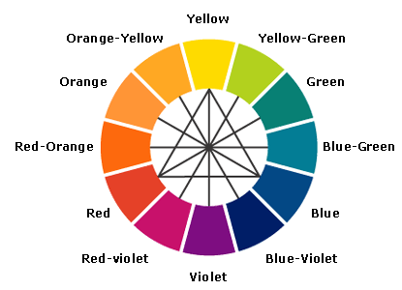
Color Wheel - Simple

Slide 18

Let’s Look
at a
Few Posters

Slide 19


Slide 20


Slide 21


Slide 22
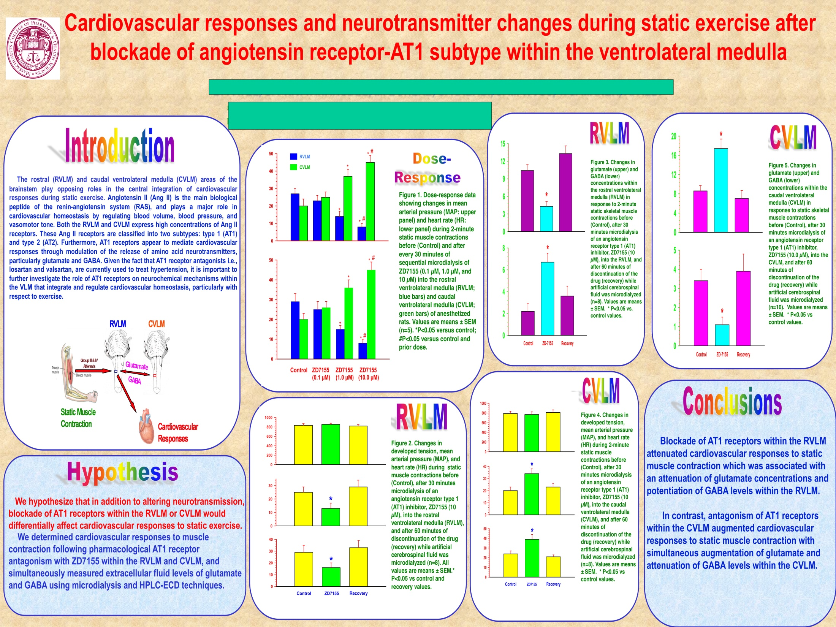

Slide 23


Slide 24


Slide 25



Slide 26
JPEG = Joint Photographic Expects Group
TIFF = Tagged Image File Format
PNG = Portable Network Group
GIF = Graphic Interchange Format

